Slide 1

Business Insights with Power BI Sales Dashboards
Transforming Data into Decisions

Slide 2
Introduction to Power BI
Power Bi is a business intelligence tool develop by Microsoft. It is simple Drag and Drop to approach to visualize , Analyze the Data and Create a beautiful Visualizations.
Power BI is a powerful Market leading, Data Visualization, Data Cleaning , Data Modeling and Business Intelligence Software.
Power BI is a Collection of Components.

Slide 3

The Importance of Sales Dashboards
Sales dashboards allow seamless data import and transformation, ensuring accurate and up-to-date information for informed decision-making.
Dashboards present sales data through visually appealing charts and graphs, making complex information easy to understand at a glance.
Users can interact with sales dashboards, exploring data, drilling down for details, and customizing views to gain deeper insights and improve sales strategies.

Slide 4
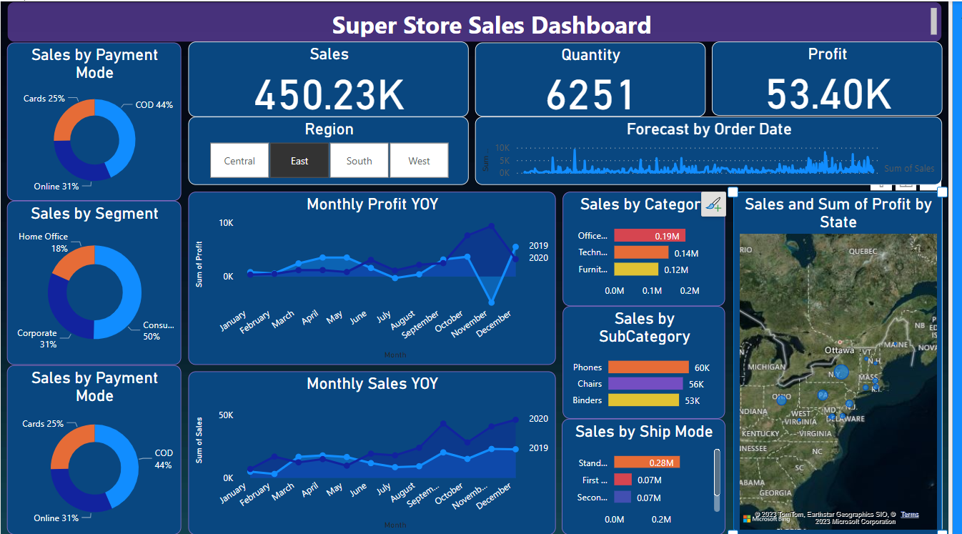
Super Store Sales Dashboard

Slide 5
Objective
Dashboard Creation: Identify the KPIs, design an intuitive and visually appealing dashboard, add interactive visualizations and filtering capabilities to allow users to explore the data at various levels of granularity
Data Analysis: Provide valuable insights to business entities regarding the effectiveness of their sales strategies through visualization and charts
Sales Forecasting: Leverage historic data and apply time series generate sales forecasts for next 15 days
Actionable Insights and Recommendations: End goal is to insights and actionable information that can drive strategic decision support the supermarket's goals for growth, efficiency, satisfaction.

Slide 6
Take Your Business to the Next Level!
The potential of data with Power BI today. This powerful tool empowers organizations to transform raw data into actionable insights. With user-friendly dashboards and robust analytics, Power BI enables informed decision-making, improved efficiency, and a competitive edge.
Its versatility spans various industries, offering customizable reports, real-time data updates, and seamless integration with other Microsoft tools. Don't miss out on the benefits of data-driven decision-making—start using Power BI now to unlock your business's full potential.

